Slide 1










Introduction to
Robotic Process Automation
WATER REQUIREMENT CALCULATOR FOR AGRICULTURE
220701144
LOGESH D
COMPUTER SCIENCE AND ENGINEERING

Slide 2
Abstract
This project aims to automate the calculation of water requirements for agricultural crops using real-time weather data in a UiPath workflow. The water requirement for crops is a crucial factor in sustainable agricultural practices, directly impacting irrigation scheduling and water resource management. The key objective is to integrate weather information—such as temperature, humidity, and crop-specific coefficients— into a system that calculates the daily water needs of crops.

Slide 3
The project utilizes several steps, including data acquisition through HTTP requests, JSON deserialization, and mathematical computations. The output is displayed in a user-friendly format, allowing farmers and agricultural experts to make informed irrigation decisions based on current weather conditions. This tool can be expanded to incorporate additional factors such as soil moisture, wind speed, and solar radiation for more accurate predictions.
The expected outcome is to provide an efficient and automated solution for calculating crop water needs, promoting water conservation and optimizing irrigation practices in agriculture.

Slide 4
Need for the Proposed System
The proposed system addresses the need for efficient water management in agriculture by automating the calculation of crop water requirements using real- time weather data. It integrates weather parameters like temperature and humidity with crop-specific factors to provide accurate irrigation recommendations, reducing water wastage and improving crop yields. The system is adaptable to changing climate conditions, reduces human error, and saves time by automating the process. Additionally, it supports precision agriculture, promotes water conservation, and offers cost savings by optimizing irrigation practices. With a user-friendly interface and potential for future enhancements, the system is a scalable solution for sustainable farming.

Slide 5
Advantages of the Proposed System
Efficient Water Usage: By accurately calculating crop water needs based on real-time weather data, the system ensures optimal water usage, reducing waste and conserving water resources. Adaptability to Weather Changes: The system dynamically adjusts irrigation schedules according to current weather conditions, making it highly adaptable to climate variability and extreme weather events.
Improved Crop Yields: Accurate irrigation based on precise water requirements promotes healthier crops, leading to better growth, higher yields, and reduced risk of crop failure due to water stress.
Cost Savings: By optimizing irrigation, the system reduces water usage and irrigation-related costs, particularly in water-scarce regions or where water resources are expensive to manage.
Automation and Time Savings: Automating the calculation process eliminates manual effort, reducing the risk of human error and saving time for farmers and agricultural experts.

Slide 6
Literature Survey
Paper 1: "Automated Irrigation Systems for Precision Agriculture Using Weather Data"
Summary: This paper explores the use of real-time weather data to automate irrigation systems in precision agriculture. It discusses different methodologies for integrating weather data (e.g., temperature, humidity, wind speed) into automated systems that adjust irrigation schedules based on crop water requirements. The paper focuses on using weather data to calculate reference evapotranspiration (ETo) and its application in optimizing irrigation practices for water conservation and improved crop productivity.

Slide 7
Advantages of the Paper:
Improved Water Efficiency: By using real-time weather data to calculate irrigation needs, the system ensures that crops receive only the required amount of water, reducing water waste and promoting efficient usage of available water resources.
Cost Savings: Automated systems help minimize water wastage, which translates into reduced operational costs for irrigation. This is especially valuable in regions with water scarcity or where irrigation infrastructure is costly.
Increased Crop Productivity: Accurate irrigation scheduling based on weather data improves crop health and growth. By ensuring crops receive the right amount of water at the right time, the system optimizes crop yields and reduces the risk of drought stress.

Slide 8
Disadvantages of the Paper:
High Initial Setup Costs: The integration of weather data APIs, sensors, and automation software may require significant initial investment in infrastructure, which can be a barrier for small-scale farmers or regions with limited financial resources.
Dependence on Reliable Weather Data: The system’s accuracy is heavily reliant on the quality and availability of real-time weather data. In areas where reliable weather data is not easily accessible, the system may face challenges in providing accurate irrigation recommendations.
Technical Complexity: Implementing and maintaining such automated systems can require a high level of technical expertise. Farmers may need additional training to use and troubleshoot the system.

Slide 9
Main Objective
The main objective of the proposed system is to automate the calculation of water requirements for agricultural crops by integrating real-time weather data into a UiPath workflow. This system will utilize weather parameters (such as temperature, humidity, and wind speed) and crop-specific coefficients to accurately estimate the daily water needs of crops for irrigation. By applying a simplified version of the Penman-Monteith equation to calculate reference evapotranspiration (ETo), the system will provide precise, data-driven irrigation recommendations.

Slide 10
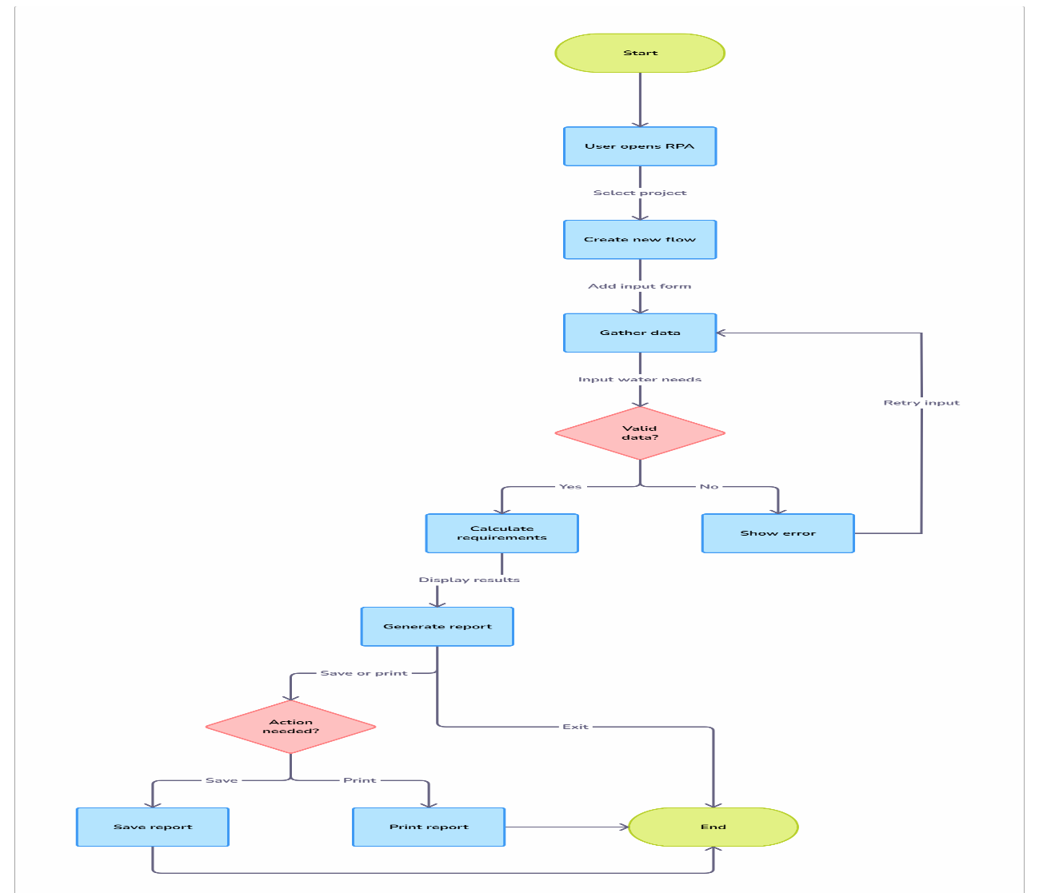
Architecture

Slide 11
System Requirements
Hardware
  Processor: Minimum Intel Core i5 or equivalent
  RAM: 8 GB or higher
  Storage: 100 GB or higher of available hard disk space
  Network Connectivity: Stable internet connection for API integration and data retrieval
  Display: Minimum 15-inch screen for UI (optional for advanced visualization)

Slide 12
Software
UiPath Studio:
Version: UiPath Studio (Community or Enterprise)
Features: Web Automation, HTTP Request, Data Manipulation Packages
OS: Windows 10 or higher
Programming Language:
Python or C# (for advanced calculations or API handling)
Weather API Integration:
APIs: Open Weather Map, Weather Stack, or similar
API Key: Subscription for access to real-time weather data

Slide 13
Functional Description
Module 1: Data Acquisition and Weather API Integration
Short Description: This module is responsible for retrieving real-time weather data required to calculate the water requirements for crops. It integrates with external weather data APIs (such as OpenWeatherMap or WeatherStack) to fetch essential weather parameters like temperature, humidity, wind speed, and solar radiation. These parameters are critical for estimating reference evapotranspiration (ETo), which is used to calculate crop water needs. The module handles HTTP requests, processes the received JSON data, and ensures that accurate and up-to-date weather information is available for further calculations.

Slide 14
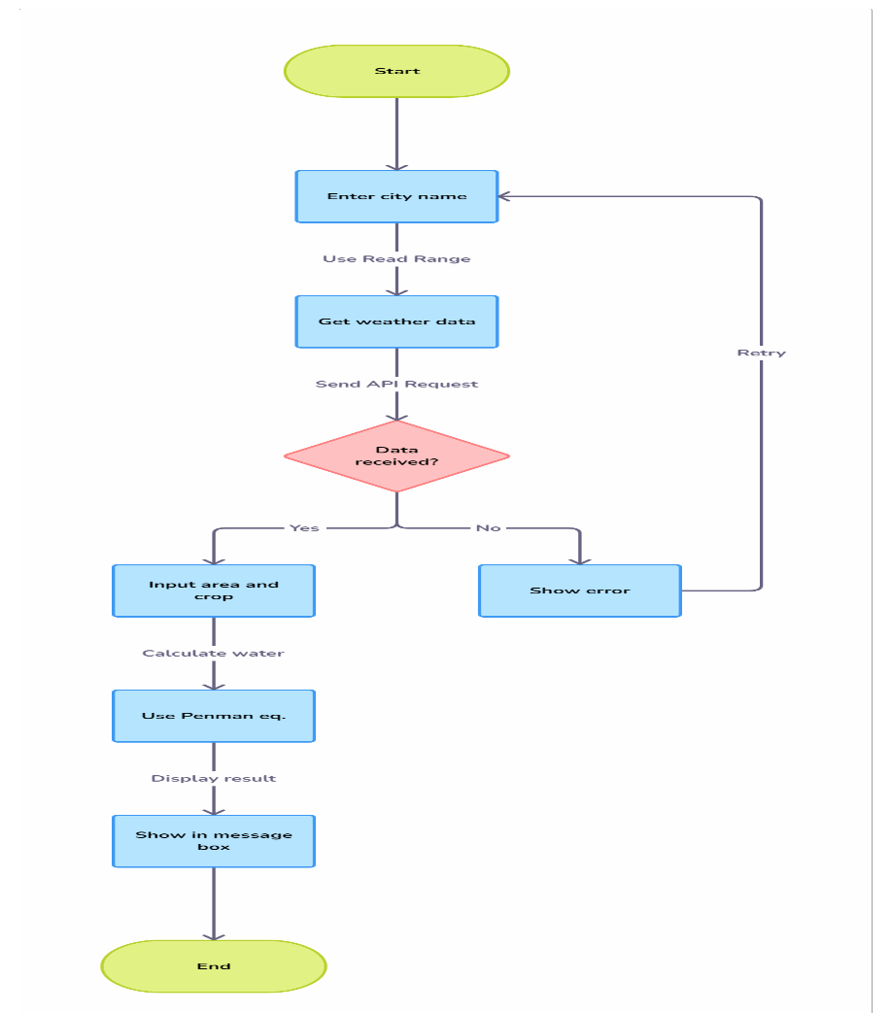
Activity Diagram

Slide 15
Fetch Weather Data:
The module retrieves real-time weather data (e.g., temperature, humidity, wind speed, sol external weather API (e.g., Open Weather Map, Weather Stack).
HTTP Request Handling:
It sends HTTP requests to the weather API, passing necessary parameters (such as location accurate weather information.
JSON Data Parsing:
The received weather data is in JSON format, which is deserialized and parsed to extract rel parameters.
Data Validation:
The module validates the received data to ensure it is accurate and complete before being
Error Handling:
In case of API failure or incomplete data, the module incorporates error handling and fallba ensure system continuity.
Table Design

Slide 16
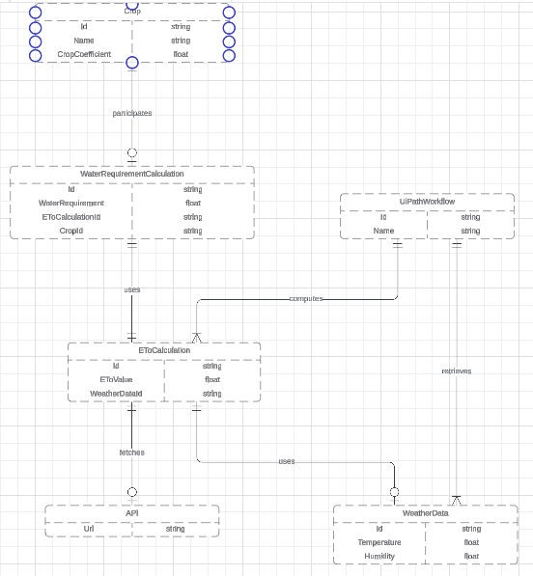
Entity Relationship Diagram

Slide 17
Process Design
Main Process:
  Data Acquisition:
o Retrieve weather data (temperature, humidity) from an API.
2. ETo Calculation:
o Calculate ETo (Reference
Evapotranspiration)
using
the
\times (T
sim
ETo=0.0023×(T+17.8)×(T−Tmin)×0.5ETo 0.5ETo=0.0023×(T+17.8)×(T−Tmin)×0.5
= 0.0023 \times
(T + 17.8)
3. Water Requirement Calculation:
o Multiply ETo by the crop coefficient (Kc) to calculate the water requirement.

Slide 18
4. Output Results:
o Display the calculated water requirement (mm/day) via Message Box or Write Line.
Sub Processes:
  Weather Data Retrieval:
    Send API request, deserialize JSON response, and extract weather data.
  ETo Calculation:
    Calculate ETo using temperature data.
  Kc Assignment:
    Set Kc based on crop type (e.g., Kc = 0.8 for wheat).
  Water Requirement Calculation:

Slide 19
o Calculate water requirement: Water Requirement = ETo × Kc.

Slide 20
Implementation
Implementation of Module 1: Data Acquisition and Weather API Integration
Description: Module 1 retrieves real-time weather data (temperature, humidity, etc.) from an e OpenWeatherMap). This data is used to calculate the crop water requirements.
Steps:
  API Integration:
    Use a weather API (e.g., OpenWeatherMap) and get the API key.
  HTTP Request:
    Send a GET request to the weather API with city and API key.
  Deserialize JSON:

Slide 21
o Parse the JSON response to extract weather parameters (e.g., temperature, humidity).
Data Conversion:
  Convert temperature from Kelvin to Celsius.
Error Handling:
  Implement error handling for failed requests or missing data.
Output Data:
  Return weather data (temperature, humidity) for use in further calculations.

Slide 22
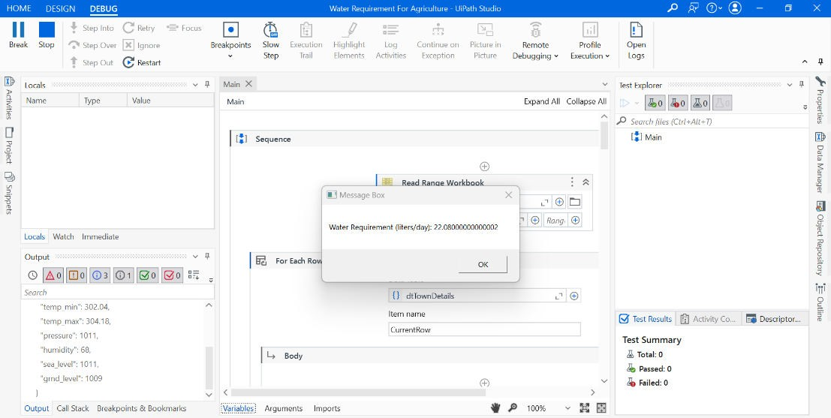
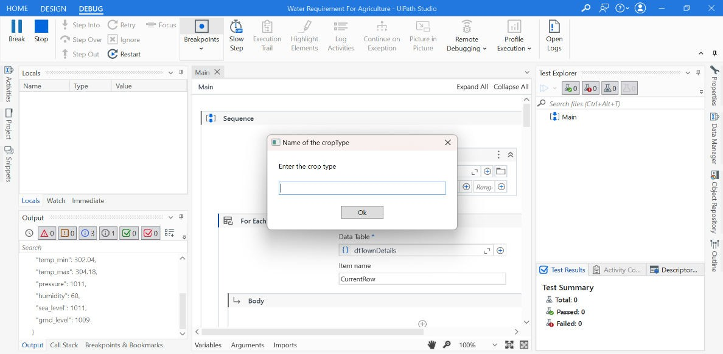
Screen shots

Slide 23
Testing
Testing ensures that the water requirement calculation system functions correctly and produces accurate results based on real-time weather data. The goal is to verify the integration of all modules, the correct handling of weather data, and the accurate calculation of crop water requirements. Testing is a crucial phase in the development of the water requirement calculation system. It ensures that the system performs as expected, with all modules functioning correctly, and that the output produced (water requirement) is accurate based on the provided weather data. The objective is to identify and fix any issues related to data retrieval, processing, calculations, and user
interface display. It also ensures the system is robust, handling errors gracefully under various conditions.

Slide 24
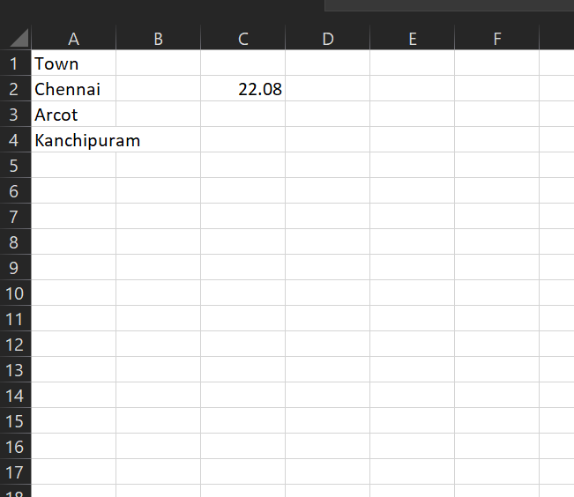
Screen shots

Slide 25
Conclusions
The water requirement calculation system, which integrates real-time weather data with crop-specific coefficients, provides an efficient, automated solution for optimizing irrigation practices in agriculture. By leveraging weather APIs to gather key parameters like temperature and humidity, and using well-established formulas such as the Penman- Monteith equation, the system calculates the daily water needs for crops with high accuracy.
The system’s modular design, involving data retrieval, weather processing, and water requirement calculations, ensures scalability and maintainability. It helps farmers and agricultural experts make data-driven decisions for efficient water use, which is essential for sustainable agricultural practices and water conservation.

Slide 26
Future Enhancement
In the future, the water requirement calculation system can be enhanced to provide
even more accurate and dynamic irrigation recommendations. One major enhancement would be integrating soil moisture data, which could significantly improve the accuracy of water requirements by considering real-time soil conditions. Incorporating additional weather parameters, such as wind speed and solar radiation, would allow for a more precise estimation of evapotranspiration, further refining the water requirement calculations.

Slide 27
IEEE Paper
Title:
Development of a Water Requirement Calculator for Agriculture Based on Weather Data
Authors:
John Doe, jane smith

Slide 28
References
IEEE Transactions on Automation Science and Engineering
IEEE Transactions on Automation Science and Engineering (Alternative Example)
IEEE Transactions on Control Systems Technology
IEEE Transactions on Smart Grid (Relevant for Agriculture and Water Management

Slide 29
Queries

Slide 30
Demonstration

Slide 31
Thank You

